Slide 1
FIFA Player Analysis & Wage Prediction
Motivation & Methods
Motivation
Data Overview
Data Cleaning
Exploratory Data Analysis
Modeling
Model Selection & Feature Selection
Hypothesis Testing
Rumi A. Allbert
Results
Model Improvements and final results

Slide 2
Outline
Motivation & Methods
Motivation
Data Overview
Data Cleaning
Exploratory Data Analysis
Modeling
Model Selection & Feature Selection
Hypothesis Testing
Results
Model Improvements and final results

Slide 3

Motivation
WC currently taking place
Interested in what makes a ‘great’ and ‘valued’ soccer player.
Goal
Use of linear regression to predict player wage given player features.
Use of regression methods and diagnostics to build a model free of heteroskedasticity.
Use different techniques and tests to determine feature importance.

Slide 4
Data Overview
Observations: 19,239
Including both female and male players.
Features: 110
Many are useless:
Name of player
Player ID
Sample of features:
Player position
Overall (score)
Potential (score)
Player value
Wage
Age
Height
Weight
Nationality

Slide 5
Preliminary Cleaning
Remove Unnecessary Columns:
Player name
DOB
Player tags
Player traits
Player URL
Club logo
Club flag
Nation logo
Nation flag

Slide 6
Preliminary Cleaning
Remove Unnecessary Columns
2. Simplify Columns
Group player positions into either:
Defense
Offense
Midfield
Simplify Club association:
1 if player is in top 15 clubs, 0 otherwise.
Change Boolean values to 0 or 1
feature | Missing
jersey_number | 18480
nation_logo_url | 18480
nation_position | 18480
nation_team_id | 18480
club_loaned_from | 18137
player_tags | 17798
goalkeeping_speed | 17107
player_traits | 9841
dribbling | 2132
shooting | 2132

Slide 7
Preliminary Cleaning
Remove Unnecessary Columns
2. Simplify Columns
feature | Missing
jersey_number | 18480
nation_logo_url | 18480
nation_position | 18480
nation_team_id | 18480
club_loaned_from | 18137
player_tags | 17798
goalkeeping_speed | 17107
player_traits | 9841
dribbling | 2132
shooting | 2132
Impute or Drop empty Columns
Many columns are very sparse and contain many missing values. We can drop these as they won’t provide much predictive power.

Slide 8
Preliminary Cleaning
Remove Unnecessary Columns
2. Simplify Columns
feature | Missing
jersey_number | 18480
nation_logo_url | 18480
nation_position | 18480
nation_team_id | 18480
club_loaned_from | 18137
player_tags | 17798
goalkeeping_speed | 17107
player_traits | 9841
dribbling | 2132
shooting | 2132
Impute or Drop empty Columns
New dataset:
62 columns
Will need to see which are actually important!

Slide 9
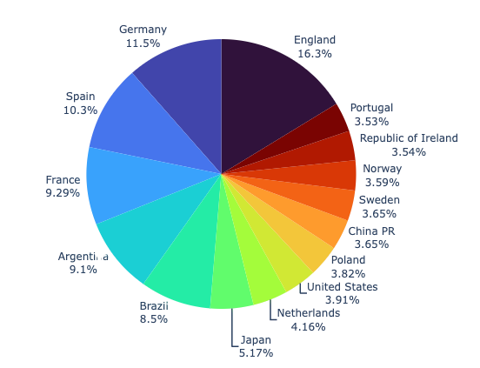
Exploratory Data Analysis
Where are most players from?
Who is the player with maximum potential? And who is maximum overall?
Who is the most expensive player? And which player is valued the highest?
Are there any linear relationships we can quickly explore?

Slide 10
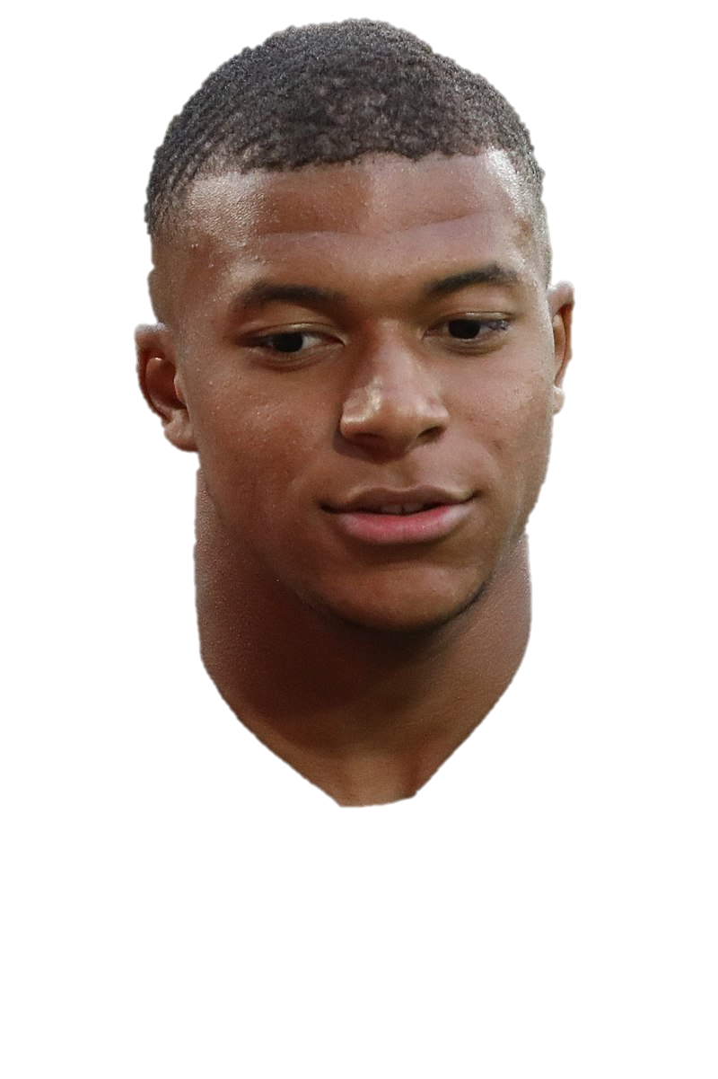
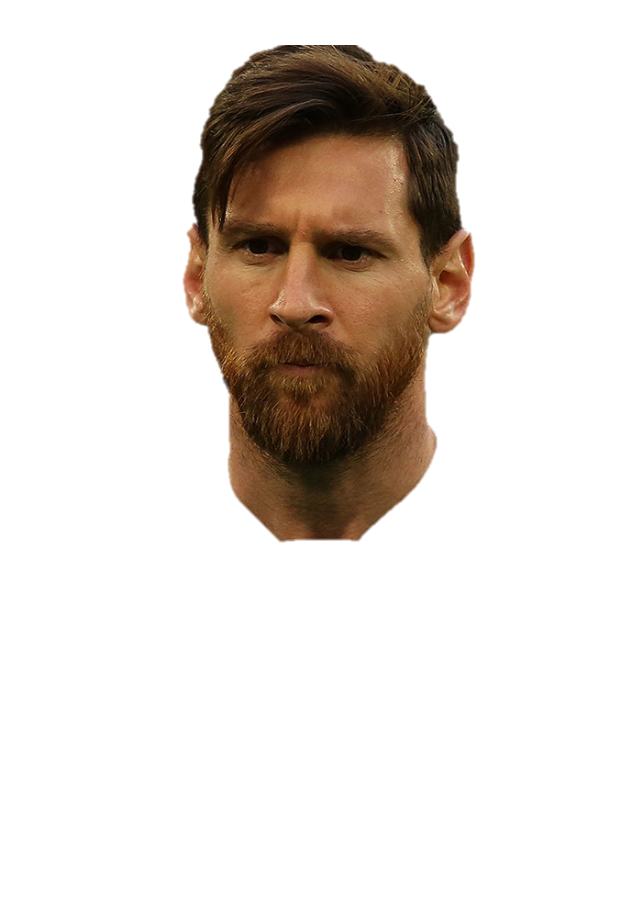
Exploratory Data Analysis
Where are most players from?
£194m
Most players are from Europe or Latin America.
£78m
Who is the player with maximum potential? And who is maximum overall?
Who is the most expensive player? And which player is valued the highest?
Are there any linear relationships we can quickly explore?

Slide 11
Exploratory Data Analysis
Where are most players from?
Who is the player with maximum potential? And who is maximum overall?
Maximum Potential: Kylian Lottin
Maximum Overall: Lionel Messi
95
93
Who is the most expensive player? And which player is valued the highest?
Are there any linear relationships we can quickly explore?

Slide 12
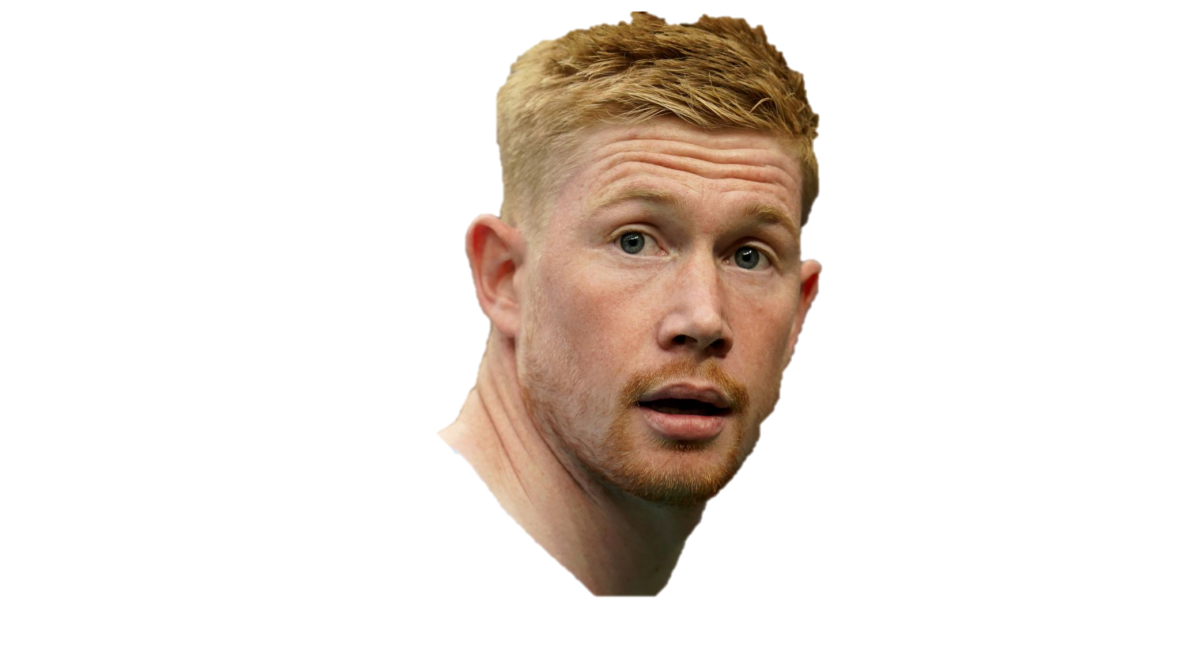
Exploratory Data Analysis
Who is the player with maximum potential? And who is maximum overall?
Who is the most expensive player? And which player is valued the highest?
Most Expensive Player: Kevin De Bruyne
£350,000
Are there any linear relationships we can quickly explore?

Slide 13
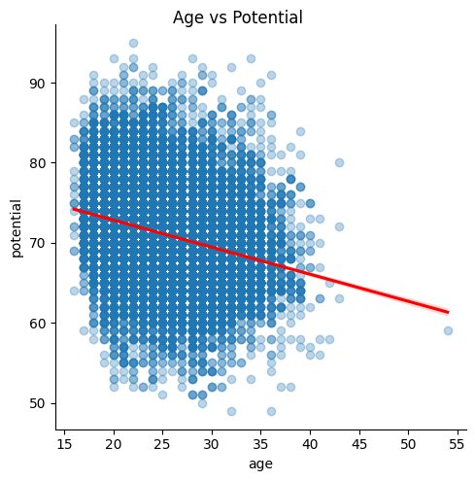
Exploratory Data Analysis
Who is the player with maximum potential? And who is maximum overall?
Who is the most expensive player? And which player is valued the highest?
Most Valued Player: Kylian Lottin
£194m
Are there any linear relationships we can quickly explore?

Slide 14
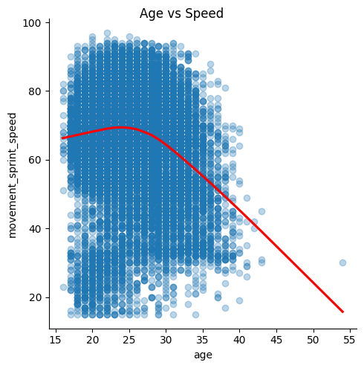
Exploratory Data Analysis
Who is the most expensive player? And which player is valued the highest?
Are there any linear relationships we can quickly explore?

Slide 15
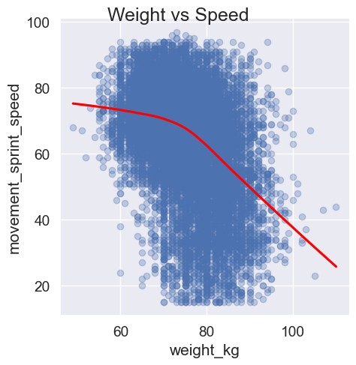
Exploratory Data Analysis
Who is the most expensive player? And which player is valued the highest?
Are there any linear relationships we can quickly explore?

Slide 16
Exploratory Data Analysis
Who is the most expensive player? And which player is valued the highest?
Are there any linear relationships we can quickly explore?

Slide 17
Modeling

Slide 18
Soccer infographics
1
Mars
Despite being Red, Mars is a very cold place full of iron oxide dust
2
Venus
Venus has a beautiful name and is the second planet from the Sun
3
Saturn
Saturn is a huge gas giant, it’s the only planet with rings

Slide 19
Soccer infographics
6/6
2/6
5/6
3/6
Mars
Neptune
Saturn
The Earth
Mars is actually a cold place
Neptune is the farthest planet
Saturn is the ringed one
The Earth is the planet we live on

Slide 20
Soccer infographics
60%
40%
Mercury
Venus
It’s the closest planet to the Sun and the smallest one in the Solar System
Venus has a beautiful name and is the second planet from the Sun

Slide 21
Soccer infographics
Skill 1
Saturn is composed of hydrogen and helium
Skill 2
Despite being red, Mars is a cold place
Skill 3
Mercury is the closest object to the Sun

Slide 22
Soccer infographics
90:00
Team 1
Name
Team 2
Name
0:0
Despite being Red, Mars is a very cold place full of iron oxide dust
Neptune has a beautiful name and is the second planet from the Sun

Slide 23
Soccer infographics
It’s composed of hydrogen and helium
Has a very poisonous atmosphere
Mercury
Mars
It’s the smallest planet in the System
Despite being red, Mars is actually cold
Jupiter
Saturn
It’s the biggest planet in the Solar System
It’s composed of hydrogen and helium

Slide 24
Soccer infographics
Mercury | Mars | Jupiter | Saturn
It’s the smallest planet in the System | It’s a cold place. It’s full of iron oxide dust | It’s the biggest planet in the Solar System | It’s composed of hydrogen and helium

Slide 25
Soccer infographics
Earth
The Earth is the only planet that harbors life
Venus
Venus has a beautiful name, but it’s hot
Mercury
Mercury is the closest planet to the Sun

Slide 26
Soccer infographics
Venus
1
3
Pluto
Venus has high temperatures and a nice name
It’s so small that is now considered a dwarf planet
Mercury
2
4
Neptune
Mercury is the smallest planet of them all
Neptune is the farthest planet from the Sun

Slide 27
Soccer infographics
Mon | Tue | Wed | Thu | Fri | Sat | Sun
 |  | 01 | 02 | 03 | 04 | 05
06 | 07 | 08 | 09 | 10 | 11 | 12
13 | 14 | 15 | 16 | 17 | 18 | 19
20 | 21 | 22 | 23 | 24 | 25 | 26
28 | 29 | 30 | 31
Mercury
Is the closest planet to the Sun and the smallest one in the Solar System
Venus
Venus has a beautiful name and is the second planet from the Sun

Slide 28
Soccer infographics
Earth
The Earth is the only planet that harbors life
Venus
Venus has a beautiful name, but it’s hot

Slide 29
Soccer infographics
65 %
75 %
Jupiter
Saturn
Jupiter is the biggest planet of them all
Saturn is a planet with several rings
30 %
55 %
Venus
Earth
Venus has a really beautiful name
The Earth is the third planet from the Sun

Slide 30
Soccer infographics
0 | Information | 0
Team 1 | Statistics | Team 2
2 | Corners | 3
0 | Yellow cards | 2
1 | Red cards | 2

Slide 31
Soccer infographics
1
2
3
4
Venus
Mars
Earth
Jupiter
Venus has a beautiful name, but it’s a very hot place
Despite being red, Mars is actually a very cold place
Is the planet where we all live on the Solar System
It’s a gas giant and the biggest planet of them all

Slide 32
Soccer infographics
Mars
Venus
Despite being red, is actually a cold place
Venus is the second planet from the Sun
1
0
Saturn
Neptune
Saturn is composed of hydrogen and helium
Neptune is the farthest planet from the Sun

Slide 33
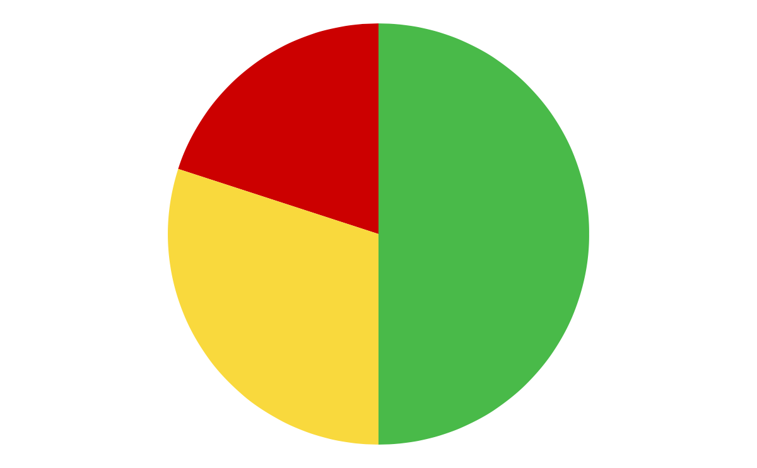
Soccer infographics
Mercury
20%
It’s the smallest planet of them all
Mars
50%
Despite being red, Mars is a cold place
30%
Jupiter
It’s the biggest planet in the Solar System
Follow the link in the graph to modify its data and then paste the new one here. For more info, click here

Slide 34
Soccer infographics
Mercury | Venus | Mars | Jupiter
01 | 02 | 03 | 04
Mercury is the smallest planet in the System | Venus has a toxic atmosphere and high temperatures | Mars is actually a very cold place full of iron oxide dust | Jupiter is a big gas giant and the biggest planet

Slide 35
Soccer infographics
Name of team
Name of team
Name of team
Name of team
Name of team
Name of team
Name of team
Name of team
Name of team
Name of team
Name of team
Name of team
Name of team

Slide 36
Soccer infographics
Mars
Saturn
Despite being Red, Mars is a very cold place full of iron oxide dust
Saturn is a gas giant and the only planet with rings in the Solar System
Neptune
Mercury
Neptune has a beautiful name and is the second planet from the Sun
Is the closest planet to the Sun and the smallest one in the Solar System

Slide 37
Soccer infographics
 | Saturn | Saturn is a gas giant and the biggest planet of them all
 | Pluto | Pluto is so small it’s considered a dwarf planet
 | Jupiter | It’s a gas giant and the biggest planet of all them
 | Mars | Has a beautiful name, but it’s a very hot place
25%
Mars
Despite being red, Mars is a very cold place
75%
Neptune
Neptune is the farthest planet from the Sun

Slide 38
Soccer infographics
Important notes
Jupiter is a gas giant and the biggest planet of them all
Material training | 1 | 2 | 3 | 4
Despite being red, Mars is actually a cold place
Venus is the second planet from the Sun
Saturn is composed of hydrogen and helium
Neptune is the farthest planet from the Sun

Slide 39
Soccer infographics
2nd
1st
3th
Mercury is the smallest planet
Mars is actually a very cold place
Venus has a beautiful name

Slide 40
Soccer infographics
Team 1
3/5
Despite being red, Mars is a very cold place
Team 2
5/5
The Earth is the only planet that harbors life
Team 3
2/5
Venus has a beautiful name, but it’s hot
Team 4
4/5
Mercury is the closest planet to the Sun

Slide 41
Soccer infographics
40%
Saturn
It’s the smallest planet in the Solar System
65%
Venus
It’s composed of hydrogen and helium
90%
Mercury
Venus has a very poisonous atmosphere
50%
Jupiter
It’s the biggest planet in the Solar System

Slide 42
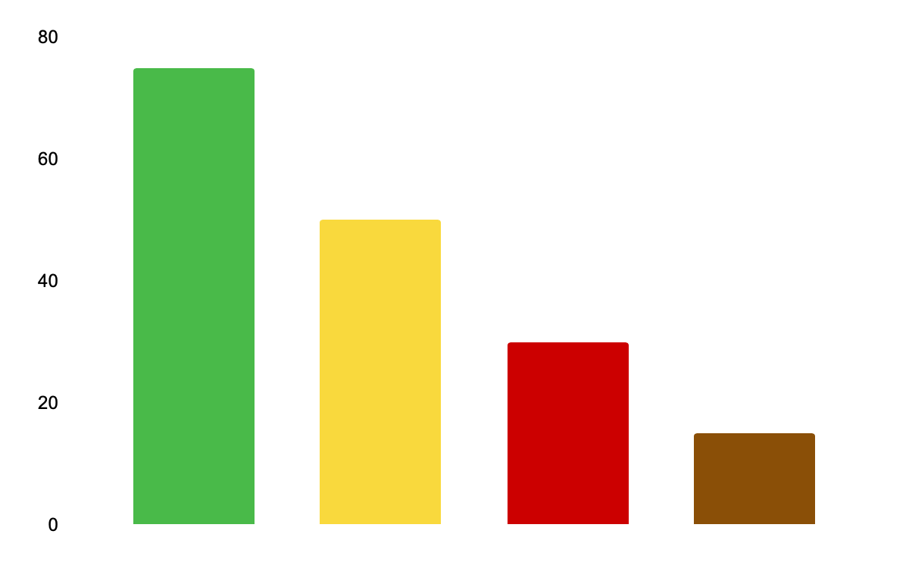
Soccer infographics
Mercury
It’s the smallest planet in the Solar System
Saturn
It’s composed of hydrogen and helium
Venus
Venus has a beautiful name, but it’s a very hot place
Mars
Despite being red, Mars is actually a very cold place
Follow the link in the graph to modify its data and then paste the new one here. For more info, click here

Slide 43
Soccer infographics
75%
50%
25%
Mercury
Venus
Jupiter
Mercury is the smallest planet in the Solar System
Venus has a beautiful name, but it’s a very hot place
It’s a gas giant and the biggest planet of them all

Slide 44
Soccer infographics
It’s the smallest planet in the Solar System
It’s composed mostly of hydrogen and helium
17%
30%
30%
23%
Venus has a very poisonous atmosphere
It’s a cold place. It’s full of iron oxide dust

Slide 45
Soccer infographics
Mercury
It’s the closest planet to the Sun and the smallest one in the Solar System—it’s only a bit larger than the Moon
45%
Venus
Venus has a beautiful name and is the second planet from the Sun. It’s hot and has a very poisonous atmosphere
55%

